Slide 1
Knots, Bends & Hitches
By CPO2 Pinto
EO M121.01; EO C421.01

Slide 2
Overview
Reef knot
Figure Eight knot
Bowline
Portuguese Sennit (Flat and Twisted)

Slide 3
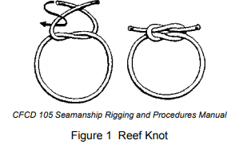
Reef Knot
Used to tie two lines of equal diameter together
Used to tie off the two ends of a line around an object
The knot is made using the following method:
1. Put the left hand working end of the line on top of the right hand working end.
2. Bring the left hand working end of the line under the right hand working end.
3. Put the working end that is now on the right on top of the working end that is now on the left.
4. Bring the working end that is on top over and then under the other working end so that the working end in the left hand comes out of the same space through which it entered the knot.

Slide 4
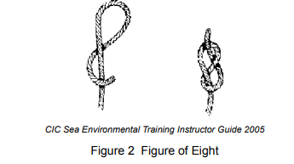
Figure Eight Knot
Stopper knot
Used to tie off the end of a line
Prevents the ends of the sheets of sails from pulling through blocks, eyebolts or fairleads
The knot is made using the following method:
1. Hold the standing end in one hand, and make a crossing turn with the working end passing under the standing part of the rope.
2. Bring the working end over the standing part.
3. Tuck the working end up through the loop from behind, forming a figure eight.
4. Pull tight on the working part.

Slide 5
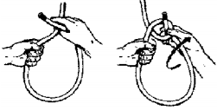
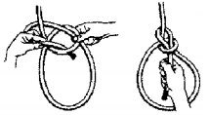
Bowline
Creates a temporary eye in a line
Used as a lifeline around a person’s waist
The knot is made using the following method:
1. With the standing end in one hand, form a small bight with the working end of the line, and lay it over top of the standing end of the line.
2. Bring the working end of the line up to form a loop at the bottom, and make the resulting loop the required size.
3. Bring the working end up through the bight and around the standing end.
4. Bring the working end down through the bight.
5. Hold the two sides of the loop and the working end in one hand, while the other hand holds the standing end of the line, and pull in opposite directions.
1
2
3
4

Slide 6
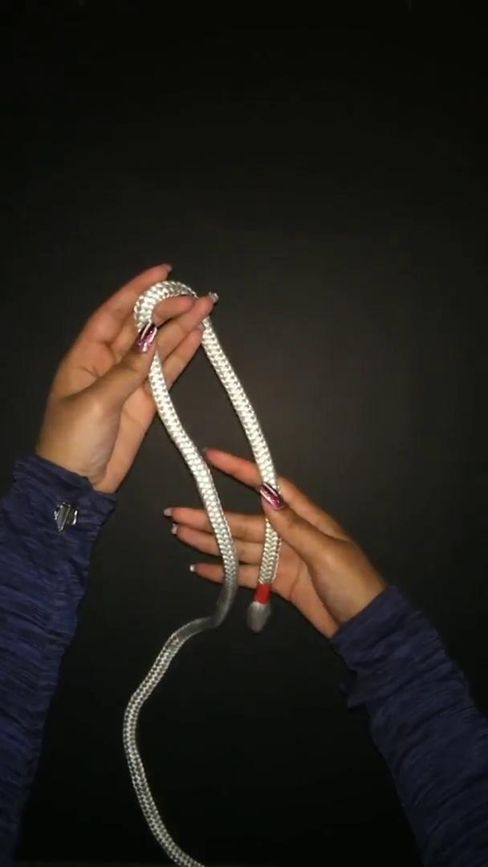
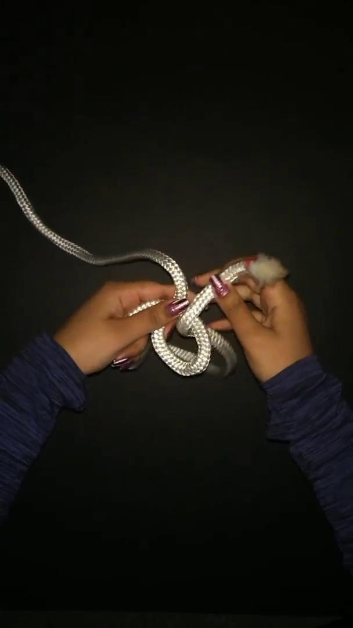
Reef Knot
Figure Eight Knot
Bowline

Slide 7
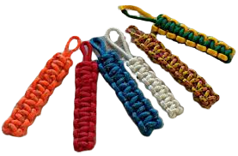
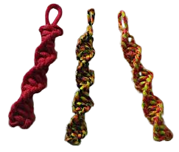
Portuguese Sennit
The Portuguese Sennit is made up of a series of half knots. It is often used for decoration purposes, such as lanyards, keychains, and boatswain belts.
The concept may be challenging to understand as it is considered Phase Four material. If you have any questions, feel free to message CPO2 Pinto.

Slide 8
Portuguese Sennit
The Sennit is made using the following method:
1. Pass a doubled line through a ring or foundation and lay the lines flat. Label the line on the left Line A and the line on the right Line B. The two centre lines will form the core of the sennit.
2. Lay Line A across the core, from left to right and pass it under Line B.
3. Pass Line B under the core and up between the core and Line A on the left.
4. Pull both lines tight, ensuring the core is kept flat. This will form a half knot.
To make a twisted Portuguese Sennit, skip to Step
5. To make a flat Portuguese Sennit, form square knots by keeping Line A on top of the core as Steps 2–4 are repeated from the opposite direction. Continue repeating and alternating direction until the desired length is attained. Skip to Step 7.
6. To make a twisted Portuguese Sennit, Steps 2–4 are repeated with the half knots tied in the same direction. If a twist to the right is desired, keep the left side line on top of the core. If a twist to the left is desired, keep the right side line on top of the core. Continue until the desired length is obtained.
7. Finish the Portuguese Sennit off by cutting the lines flush to the knots.
6;

Slide 9
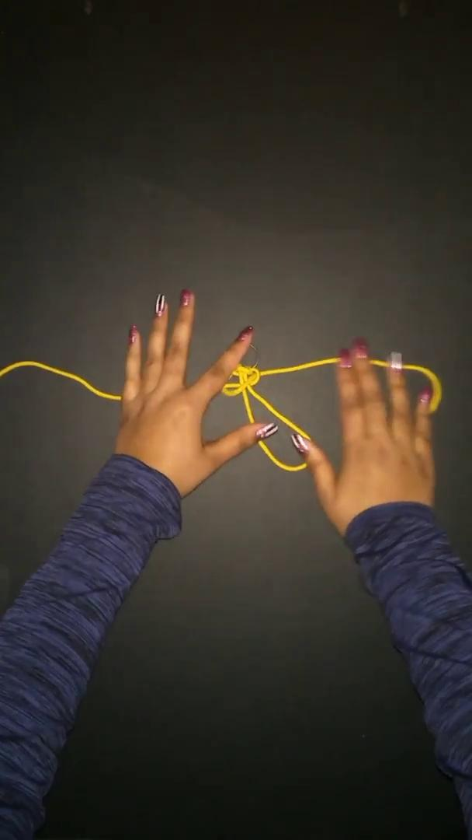
Video Demonstration

Slide 10
Thanks for Watching!
Please direct any questions to CPO2 Pinto

